Slide 1
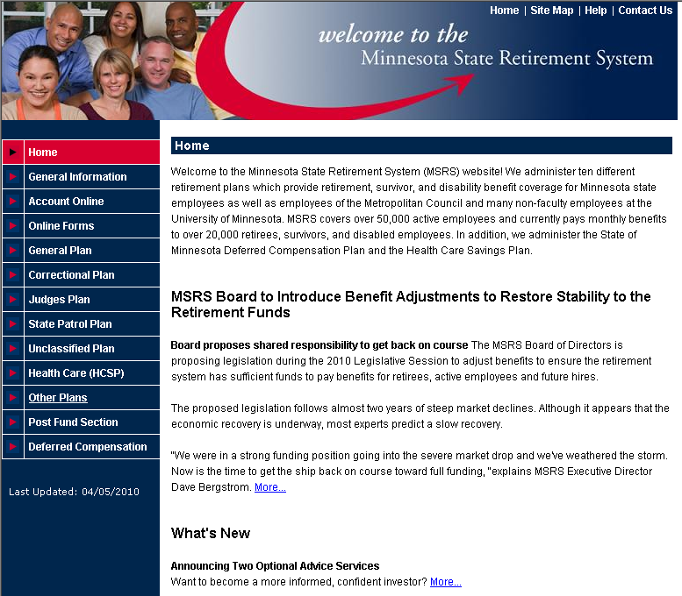
www.msrs.state.mn.us
LOGIN HERE
Notes:
AS TIME PERMITS – YOU HAVE THE OPTION TO WALK THROUGH THE ONLINE NAVIGATION SLIDES

Slide 2
MSRS Pension Login Page
MSRS Pension Login
35

Slide 3
MSRS Pension Login Page
If you do not recall your PIN, contact MSRS at 1-800-657-5757 or 651-296-2761 to have a new PIN mailed to you.
36

Slide 4
Run your own estimate request
Toggle to your MNDCP & HCSP Account Information
37

Slide 5
MNDCP & HCSP Login Page
MNDCP & HCSP Login
38

Slide 6
MNDCP & HCSP Login Page
39

Slide 7
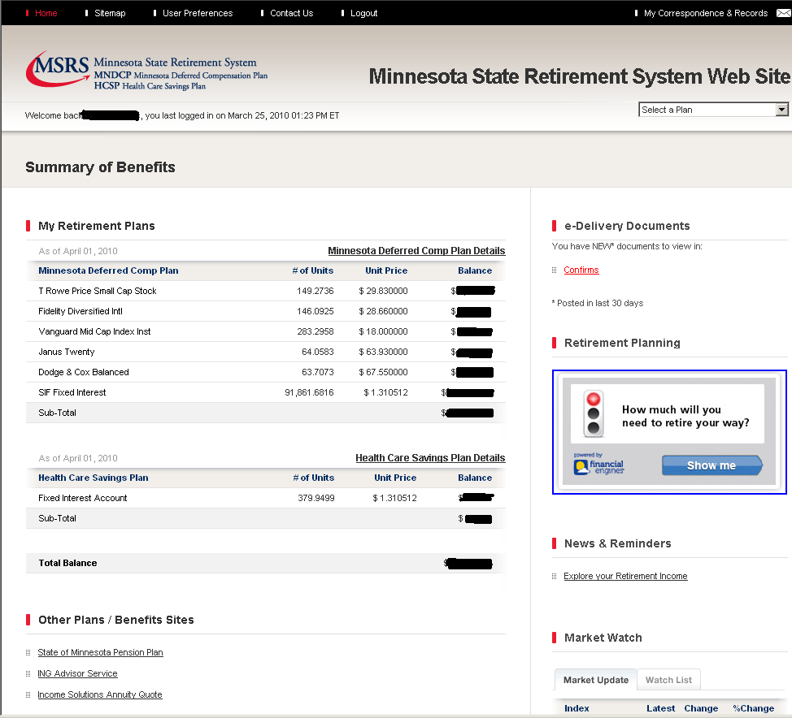
Toggle to your MSRS Pension Plan Account Information

